Slide 1
SAP HANA ADMINISTRATON 2.0

Slide 2
SAP HANA Studio
SAP HANA studio is and Eclipse based tool delivered with SAP HANA and provides an environment for administration, modeling and data provisioning.

Slide 3
SAP HANA Studio
Consists of several applications/perspectives
• Administration console
• Information modeler
• Lifecycle management
Perspectives can be switched easily
• Quick link buttons
• Welcome screen
Several SAP HANA databases can be integrated
• Navigator tree
• Folder structure
Context menu provides easy access to all functions
The administration console of the studio allows system administrators to manage the database including
creating and managing user authorizations. The studio also contains perspectives for other tasks, such as
the information modeler that allows modeling users to create new or modify existing models of data.

Slide 4
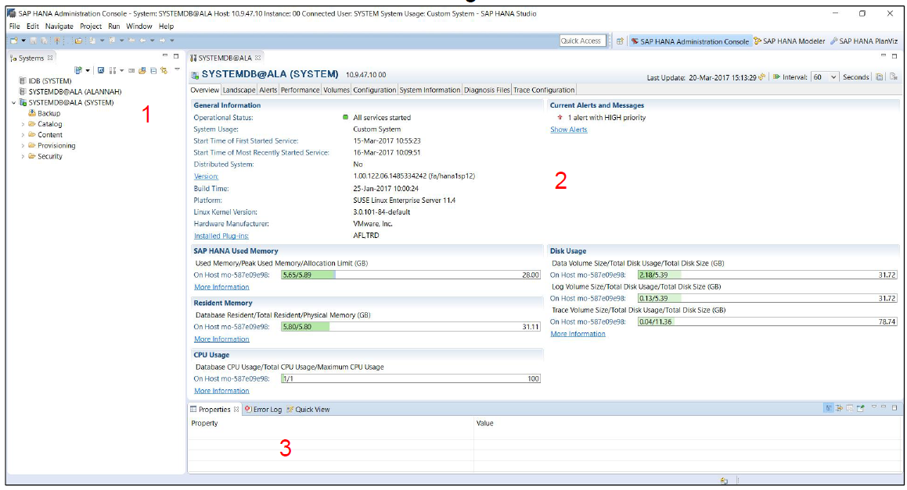
SAP HANA Studio
Admin & Monitoring Default Views:

Slide 5
Organizing the System Landscape
All SAP HANA databases of your system landscape can be integrated into the studio
• All databases connected to your studio workspace are listed in the Navigator on
the left hand side
• Working with a different users and tenants on the same database is possible
• Folders can be created in the Navigator to organize the system landscape (For example – multiple users for one
system, multiple tenants of a multi-tenant environment)
• Search functionality is available
• Using external authentication (Kerberos) is possible

Slide 6
Adding Systems
• Before you can carry out administrative tasks, you will need to
add the relevant systems to your system landscape in the
Navigator tree.
• In the Navigator, choose Add System from the context
menu/icon at top of the Navigator tree and enter the required
information.
• Hostname and Instance Number are mandatory. HTTPS and
Description are optional.

Slide 7
Adding Systems
If you are connecting to a multi-tenant
database select Multiple Containers in
the Mode section. Then there are two
scenarios:
1. If you are connecting to the System
DB, simply select System DB and
proceed as you would for a single
container system
2. If you are connecting to one of the
tenant databases then you must
specify the name of the tenant

Slide 8
Centrally-stored archive of SAP HANA systems
You can also use a centrally stored archive to efficiently connect users to multiple
HANA systems in your landscape. This way one user can centrally manage the list
of all systems in a centrally accessible location, and other users can simply link to
this archive.
1. Select “Add System Archive Link” in the Navigation Window
2. Specify Link Name and Location
3. Select “Finish”
Note: To export your list of systems (e.g. as the central archive file) select: File > Export > SAP HANA > Landscape

Slide 9
SAP HANA system logoff and logon
Users can log off actively from a HANA system using the context menu in the navigator. All connections to the specified system (JDBC, HTTP etc.) are closed after a user executes a log off in this way. Log on is accessed through the same context menu.
The start up log on behaviour of the studio is configurable under Window > Preferences > SAP HANA > Global Settings

Slide 10
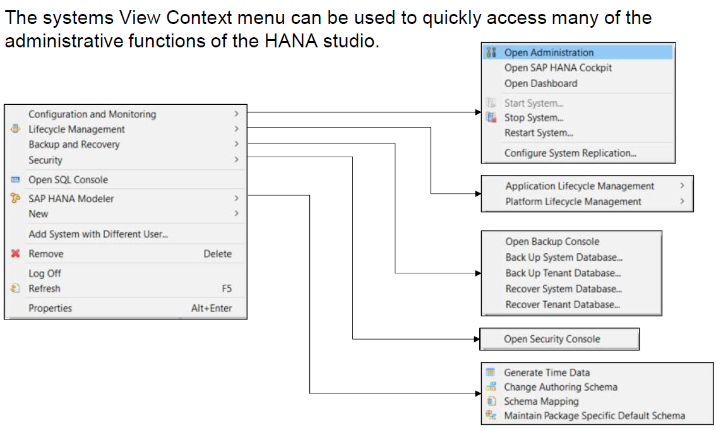
Systems View Context Menu

Slide 11
Database Start and Stop
You can perform a database Start, Stop and Restart from the context menu.
Note that you will need operating system user authentication (i.e. <SID>adm user credentials – Administrative users for HANA will be discussed later)

Slide 12
Backup
Backup, restore and snapshot functions are available in the system context menu.
You can also access the Backup Console which allows us to view the backup catalog and configuration settings for 3rd party backup integration.
Note: To use the restore functions, a database restart is required, so you will need the <SID>adm user credentials as with a stop or restart.

Slide 13
System Monitor
Provides most important information about all databases of the system
landscape at a glance
• Database state and general system information
• Alerts
• Memory usage
• CPU usage
• Disk usage
Detailed information in several areas is accessible via double-clicking on one of the available
metrics. The information displayed is configurable using the “configure viewer” button
highlighted below.

Slide 14
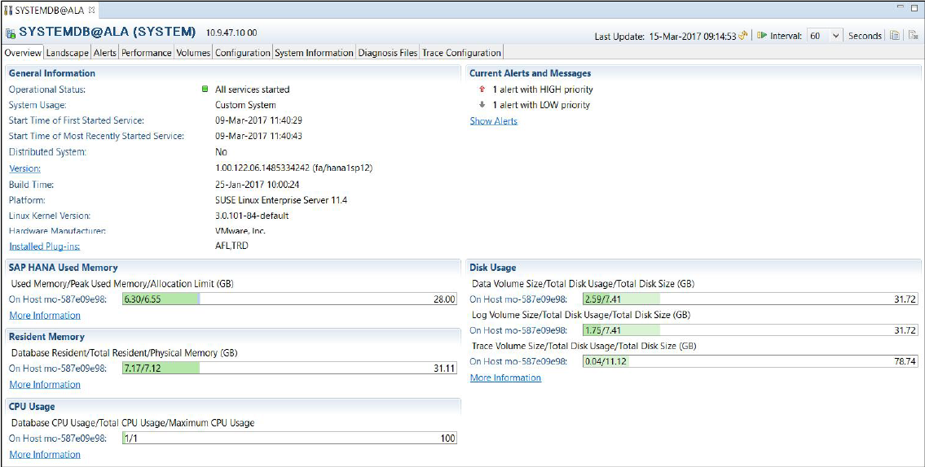
Administration View Overview
The administration view provides the most important information about one database at a glance. Double click on the instance in the navigator view to open.

Slide 15
Administration View Overview
Provides overview of critical database information including:
• Database state and general system information
• Alerts
• Memory usage
• CPU usage
• Disk usage
We can also access further information on many key database metrics using the
links on the administration overview page:

Slide 16
Administration View Landscape Tab
List of all services (processes), their status and resource consumption
• Name server
• Index server
• Preprocessor
• XSengine
• Compileserver
• Daemon
Under the Hosts Sub-Tab we can view the configuration of the system host(s) and their role (master, standby, …)

Slide 17
Administration View Alerts
The alerts tab displays the alerts generated by the statistics service.
You can also use this tab to:
• View the status of all checks
• Configure email notifications
• Configure warning level thresholds

Slide 18
Administration View Performance Tab
Performance Tab - Threads and Sessions sub-tabs
• Threads tab shows
thread type, related
service, method and
other details
• Sessions tab shows
connected users,
session status,
connection info and
other details
• Information
displayed on both
tabs is configurable

Slide 19
Statement Monitoring – Plan Cache & Statement Trace
The SQL Plan Cache automatically collects
statistics about statement execution:
Expensive Statements are shown in the
Expensive Statements Trace tab:

Slide 20
Performance Tab – Other Functions
Information on Blocked Transactions and Job Progress is also available.
• Another Key feature of the performance tab is the load graph which can be used to display the data for many key HANA metrics over time.

Slide 21
Administration View Volumes
The volumes tab displays detailed information about storage size and usage
• Size of data area
• Size of log area
• Size of storage areas
• Usage of storage areas
• Two different views - grouped by service and grouped by storage

Slide 22
Administration View Configuration
This tab shows the contents of all INI files which contain the
HANA system parameters.
Using the configuration tab it is possible to:
• View the parameter configuration of the HANA system
• Modify and reset default parameter values on a system wide or
host-by-host basis
• Compare parameters between hosts on multi-node systems

Slide 23
Administration View System Information
The System Information tab contains list of useful SQL statements
which can be used to access monitoring data for many areas,
such as:
• Memory usage
• Lock wait time
• Merge statistics
• Expensive Statements
• Garbage Collection
You can add or import SQL queries of your own to
this tab if there are custom monitoring statements
which you regularly execute on the system.

Slide 24
Administration View Log Files / Traces
The diagnosis files tab displays all HANA trace, log and dump files.
These files are generated automatically by the system according to your trace settings, as well as in certain exceptional situations (Out-of-memory dumps, system crashes etc.). You can view these traces or dump files in the studio or download them for local use (recommended in the case of large files).

Slide 25
Collecting Diagnosis Information
The diagnosis files tab can also be used to collect a full system info dump or generate a sequence of runtime environment dumps. If you contact SAP support regarding an issue on your system, our support colleagues may ask you to provide this information to assist in their analysis.

Slide 26
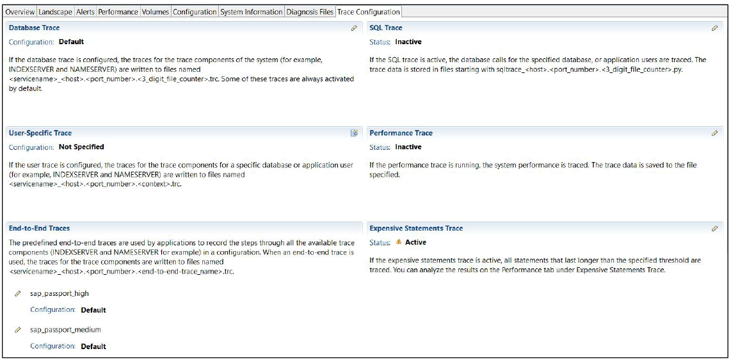
Administration View Trace configuration
SAP HANA provides several different options for tracing various activities and functions on the system.
These can be activated and configured on the Trace Configuration tab in the Studio

Slide 27
Row Store vs. Column Store When to Use Which Store
Modeling Only Possible For Column Tables
This answers the frequently asked question:
"Where should I put a table – row store or column store?"
Information Modeler only works with column tables
Replication server creates tables in column store per default
Data Services creates tables in column store per default
SQL to create column table: "CREATE COLUMN TABLE ..."
Store can be changed with "ALTER TABLE …"
System Tables Are Created Where They Fit Best
Administrative tables in row store:
Schema SYS ->caches, administrative tables of engine
Tables from statistics server
Administrative tables in column store:
Schema _SYS_BI -> metadata of created views + master data for MDX
Schema _SYS_BIC -> some generated tables for MDX
Schema _SYS_REPO -> e.g. lists of active/modified versions of models

Slide 28
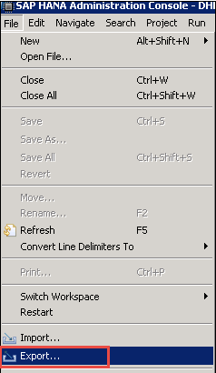
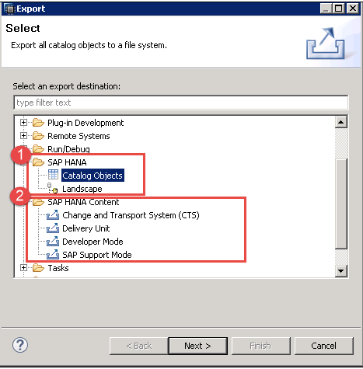
SAP HANA Export and Import
Export and Import option of SAP HANA Provide features to move tables, Information View, landscape to
other or on the same system.
Export:
Go To File Menu->Choose Export.
A Pop-Up for Export will be displayed
There are two Export options for SAP HANA Object will be displayed
SAP HANA
Catalog Objects: Used for export catalog objects (table, view, procedure, etc.).
Landscape: Used for an export landscape from one system to another.
SAP HANA Content
Change and Transport System (CTS): Used for export information
view with ABAP program.
Delivery Unit: Delivery Unit is a single unit. This option is used to export multiple package
which is mapped to single delivery unit.
Developer Mode: This option can be used to export individual objects to a location
in the local system.
SAP Support Mode: This can be used to export the objects with the data
for SAP support purposes.

Slide 29
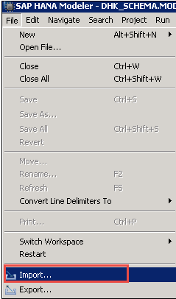
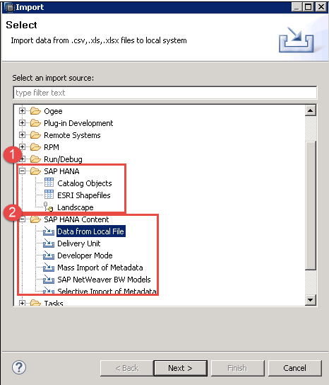
Import
Go To File Menu->Choose Import.
A pop-up for Import Option will be displayed –
There are two Import option for SAP HANA Object will be displayed –
SAP HANA
Catalog Objects: Used for import catalog objects
(table, view, Procedure, etc.).
Landscape: Used for import landscape from one system to another.
SAP HANA Content
Data from Local file: Used for import data from .csv, .xls, .xlsx file in table.
Delivery Unit: Delivery Unit is a single unit. This option is used to import
multiple package which is mapped to single delivery unit.
Developer Mode: This option can be used to import individual objects to a location
in the local system.
Mass Import of Metadata: This can be used to import the Metadata of Mass objects.
SAP Net weaver BW models: This can be used to import BW Models into SAP HANA.
Selective Import of Metadata: This can be used to import the Metadata of Single
objects into SAP HANA.

